Slide 1

ECG-IMAGE BASED HEARTBEAT CLASSIFICATION FOR ARRHYTHMIA DETECTION USING IBM WATSON STUDIO
Presented by:
Team no: CSE-B003
SALLA SAKETH(18UK1A0A7)
THALLADA SAI TEJA(18UK1A05B2)
PALAKURTHI RAHUL(18UK1A05A1)
GAYAPU SINDHU(18UK1A0D2)

Slide 2
OUTLINE
INTRODUCTION
OBJECTIVE
IMAGE DATA PROCESSING
MODEL BUILDING
SOFTWARE REQUIREMENTS
CONCLUSION

Slide 3
INTRODUCTION
There are various types of arrhythmias and each type is associated with a pattern, and as such, it is possible to identify and classify its type. The arrhythmias can be classified into two major categories. The first category consists of arrhythmias formed by a single irregular heartbeat, herein called morphological arrhythmia.
The other category consists of arrhythmias formed by a set of irregular heartbeats, herein called rhythmicarrhythmias. The classification of normal heartbeats and the ones composing the former group are on the focus of this sur_x0002_vey. These heartbeats produce alterations in the morphology or wave frequency, and all ofthese alterations can be identified by the ECG exam.
The process of identifying and classifying arrhythmias can be very troublesome for a human being because sometimesit is necessary to analyze each heartbeat of the ECG records

Slide 4
OBJECTIVE
By the end of this project you will:
know fundamental concepts and techniques of the Artificial Neural Network and Convolution Neural Networks
Gain a broad understanding of image data.
Work with Sequential type of modeling
Work with Keras capabilities
Work with image processing techniques
know how to build a web application using the Flask framework.

Slide 5
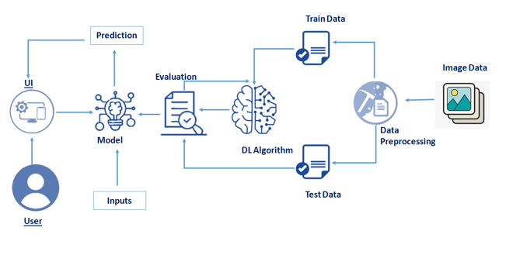
FLOW CHART

Slide 6
IMAGE DATA COLLECTION
Artificial Intelligence is a data hunger technology, it depends heavily on data, without data, it is impossible for a machine to learn. It is the most crucial aspect that makes algorithm training possible. In Convolutional Neural Networks, as it deals with images, we need training and testing data set.
It is the actual data set used to train the model for performing various actions. In this activity lets focus of gathering the dataset.

Slide 7
IMAGE PROCESSING
Image Pre-processing includes the following main tasks
Import ImageDataGenerator Library.
Configure ImageDataGenerator Class.
Applying ImageDataGenerator functionality to the trainset and test set.
The ImageDataGenerator accepts the original data, randomly transforms it, and returns only the new, transformed data.

Slide 8
MODEL BUILDING
We are ready with the augmented and pre-processed image data, Lets begin our model building, this activity includes the following steps
Import the model building Libraries
Initializing the model
Adding CNN Layers
Adding Hidden Layer
Adding Output Layer
Configure the Learning Process
Training and testing the model
Saving the model

Slide 9
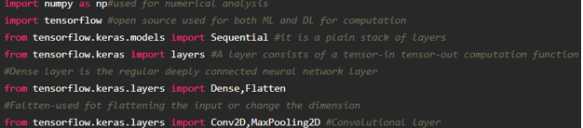
Import The Libraries
This is a very crucial step in our deep learning model building process. We have to define how our model will look and that requires.

Slide 10
Initialize The Model
Keras has 2 ways to define a neural network:
Sequential
Function API
The Sequential class is used to define linear initializations of network layers which then, collectively, constitute a model. In our example below, we will use the Sequential constructor to create a model, which will then have layers added to it using the add () method.
Now, will initialize our model.

Slide 11
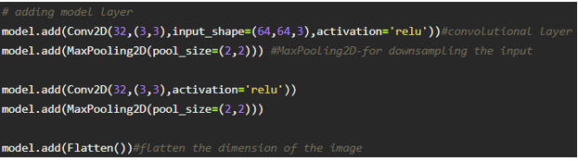
Adding CNN Layers
For information regarding CNN Layers refer to the link
We are adding a convolution layer with an activation function as “relu” and with a small filter size (3,3) and a number of filters as (32) followed by a max-pooling layer.
The Max pool layer is used to downsample the input.
The flatten layer flattens the input.

Slide 12
Adding Dense Layers
Dense layer is deeply connected neural network layer. It is most common and frequently used layer.
we have 6 neurons in op layer as we have considered 6 classes
Understanding the model is very important phase to properly use it for training and prediction purposes. Keras provides a simple method, summary to get the full information about the model and its layers.

Slide 13
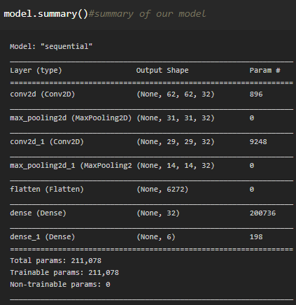

Slide 14
Configure The Learning Process
The compilation is the final step in creating a model. Once the compilation is done, we can move on to the training phase. The loss function is used to find error or deviation in the learning process. Keras requires loss function during the model compilation process.
Optimization is an important process that optimizes the input weights by comparing the prediction and the loss function. Here we are using adam optimizer
Metrics is used to evaluate the performance of your model. It is similar to loss function, but not used in the training process

Slide 15
Train The Model
Now,let us train our model with our image dataset. fit_generator functions used to train a deep learning neural network
steps_per_epoch: it specifies the total number of steps taken from the generator as soon as one epoch is finished and next epoch has started. We can calculate the value of steps_per_epoch as the total number of samples in your train dataset divided by the batch size.
Epochs: an integer and number of epochs we want to train our model for.

Slide 16
validation_data can be either:
an inputs and targets list
a generator
an inputs, targets, and sample_weights list which can be used to evaluate the loss and metrics for any model after any epoch has ended.
validation_steps: only if the validation_data is a generator then only this argument can be used. It specifies the total number of steps taken from the generator before it is stopped at every epoch and its value is calculated as the total number of validation data points in your test dataset divided by the validation batch size.
Note: it will take time for training your data based on epochs

Slide 17

Save The Model
The model is saved with .h5 extension as follows
An H5 file is a data file saved in the Hierarchical Data Format (HDF). It contains multidimensional arrays of scientific data.

Slide 18

Test The Model
Open the other jupyter file and write the code mentioned below
load necessary libraries Load the saved model using load_model
Taking an image as input and checking the results
Note the target size should for the image that is should be the same as the target size that you have used for training

Slide 19
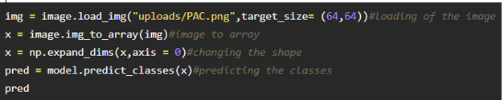
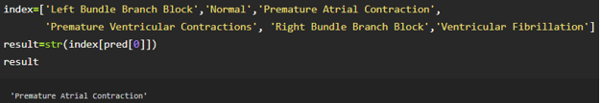
By using the model we are predicting the output for the given input images
The predicted class index name will be printed here.

Slide 20
SOFTWARE REQUIREMENTS
Anaconda navigator
Jupyter notebook
IBM watson Studio
Machine learning tools: pandas,
numpy,
matplotlib,
scikitlearn,
seaborn

Slide 21

outputs

Slide 22
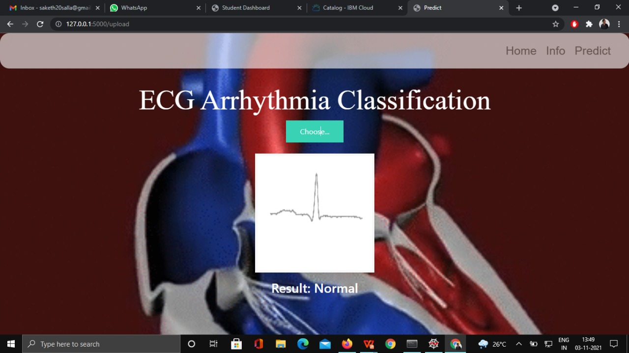
Here we given RBBB image as input it predicted Normal Block as output.

Slide 23
CONCLUSION
In this project we have predict the image based heartbeat classification for arrhythmia detection
We have achieved this by using Deep Learning model,
For better results we used CNN(Convolution Neural Network) Deep Learning Algorithm

